Slide 1
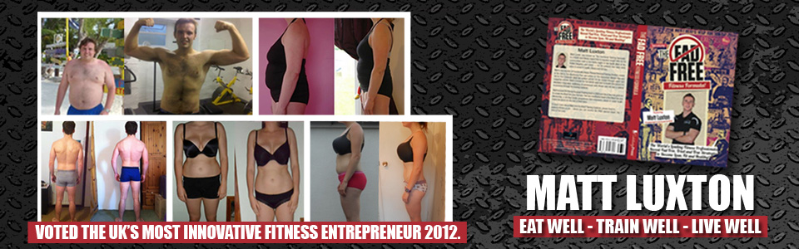
Your Nutrition, Your Lifestyle & Your Energy
Live Life To The Max
Eat Well, Train Well, Live Well

Slide 2

Who Is This Guy?
I Loved fitness from a very young age
Gym instructor...inductions
Degree and YMCA Fitness qualifications
Gold’s Gym, Venice Beach
Started REALLY studying...searching for mentorships and courses on the next level
In home PT Phenomenal results with bodyweight and band training
IHP Functional Training Specialist- 1 of 3 in Europe

Slide 3
What Have I Done So Far In My Career
Worked in the world famous Golds Gym , Venice Beach
Studied with the Worlds Best - fields of nutrition, PT, IHP
UK’s Most Innovative Fitness Entrepreneur 2012
Co – Authored International Best Selling Fad Free Fitness Book
Owner of FA Fitness Personal Training
Creator of The Blast Fitness Camps
£5K a year on education minimum

Slide 4
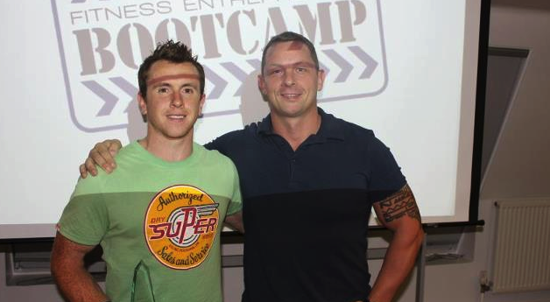
Who am I?

Slide 5

Who am I?
Amazon Best Seller September 2012

Slide 6

Commitment To Learning
Thailand March 2011- Masterminding
Back Pain with Austin Lawrence
Performance Coaching
Elimination Diet Coaching Course
Training For warriors (Edinburgh)
Private Mentoring in 2011- Dax Moy
Private Mentoring in 2012- Paul Mort
Masterminding In Spain in May 2012
CrossFit Certification – June 2012
Endocrinology course in October 2012
Phil Richards Performance- Seminar January 2013
Masters In Nutrition & Exercise Science 2013- ongoing
P R Performance- Strength & Athletic Development (Oct 2013)
Mastermind Namibia (Dec 2013) ☺
Olympic Weight Lifting (September 2014)
BTN Nutrition Academy (Jan 2015)

Slide 7

But....I am like you!
I LOVE MY CYCLING
I LOVE FEELING HEALTHY
I LOVE BEING READY FOR ANY CHALLENGE
I too...like the sugary snacks
There’s my weakness right there

Slide 8
A Few Rules
Save questions until the end
I Don’t Preach- I’m just telling you what we do
Mobiles Off
Keep an Open Mind
I have bought back up

Slide 9


Slide 10
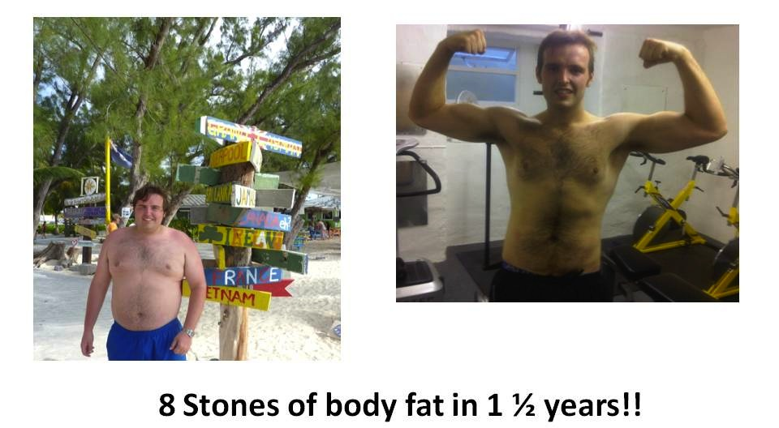
Results

Slide 11
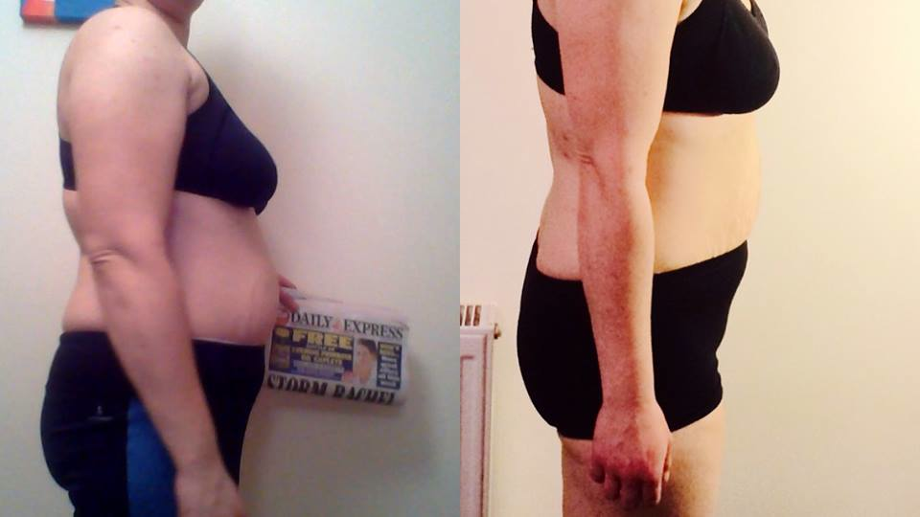

Slide 12
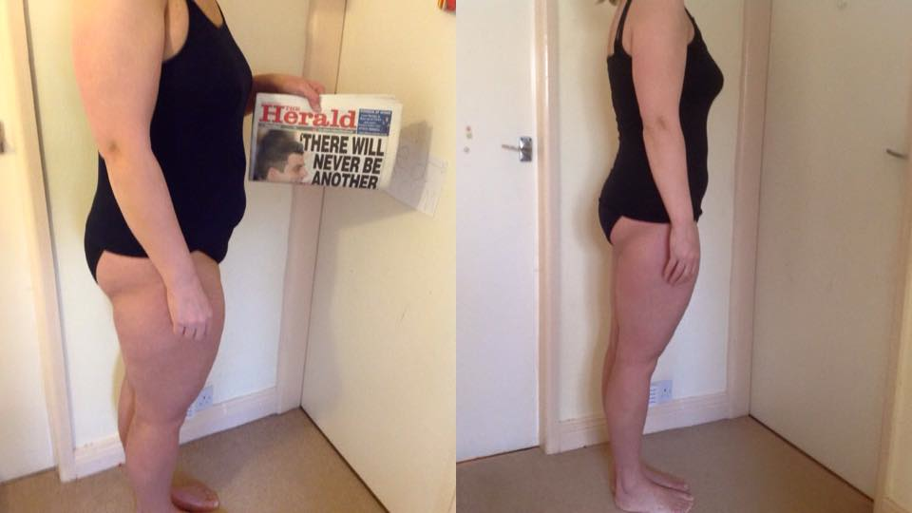

Slide 13


Slide 14
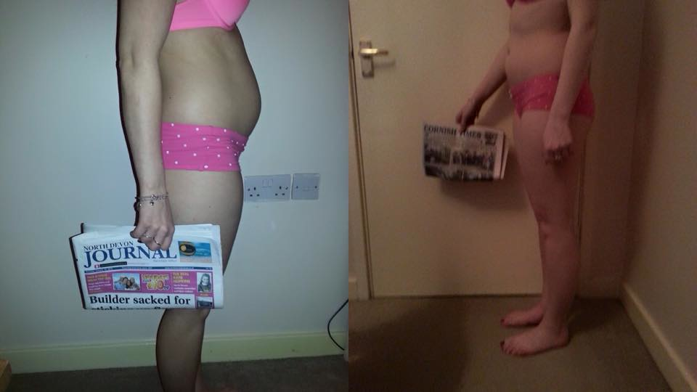

Slide 15
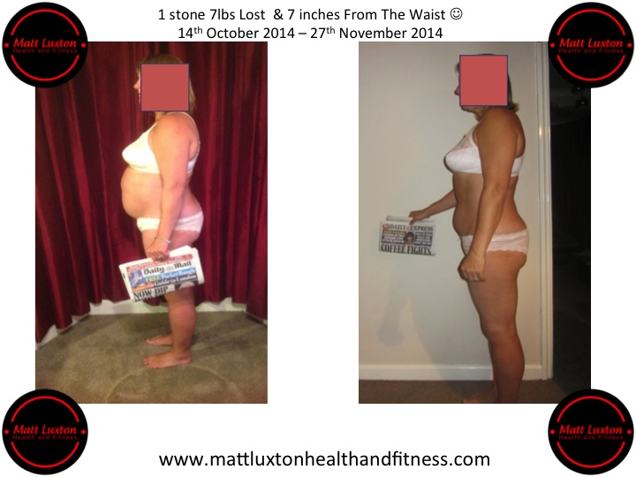
Results

Slide 16
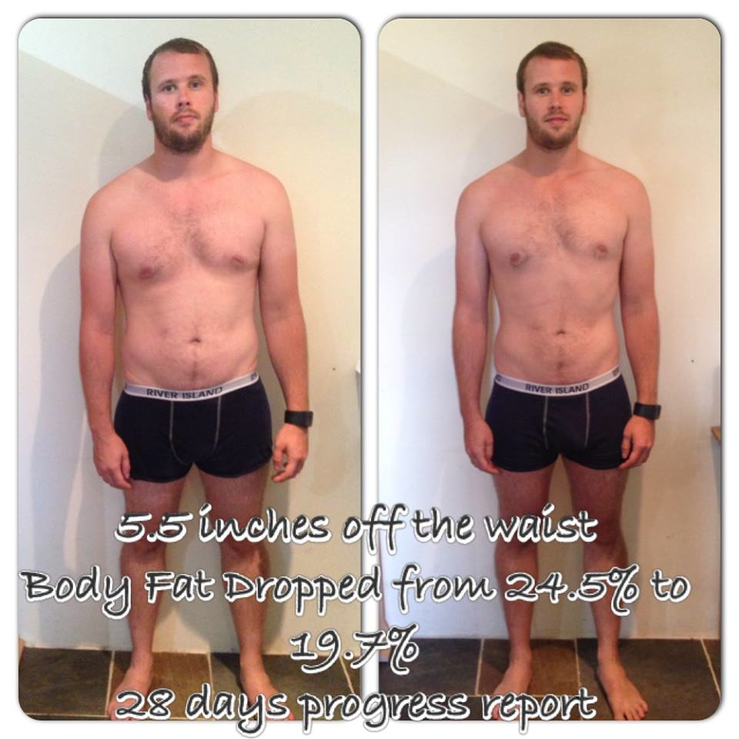

Slide 17
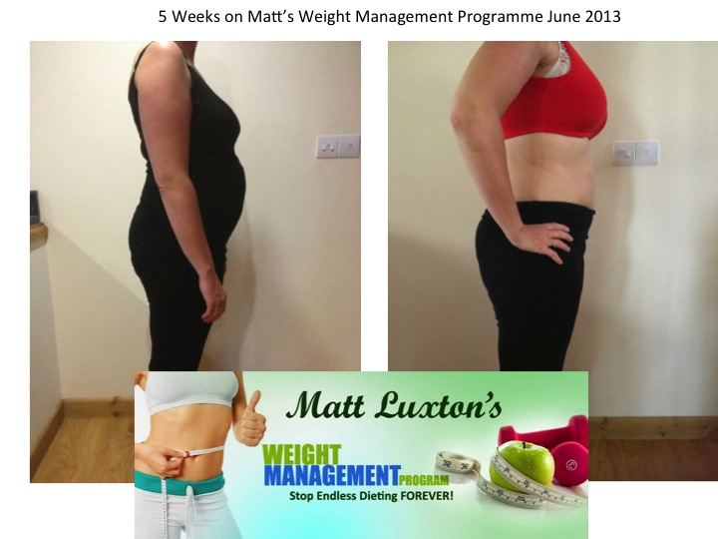

Slide 18
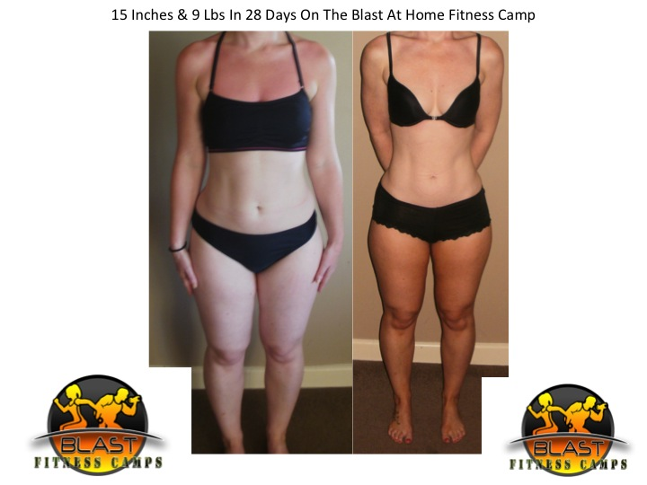

Slide 19
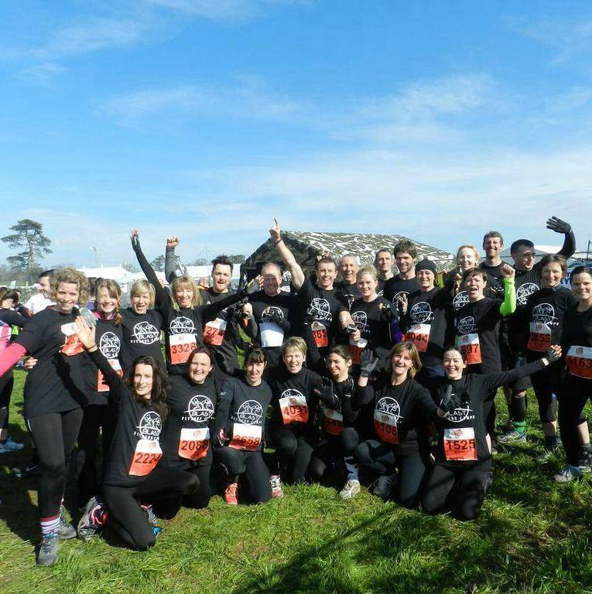

Slide 20
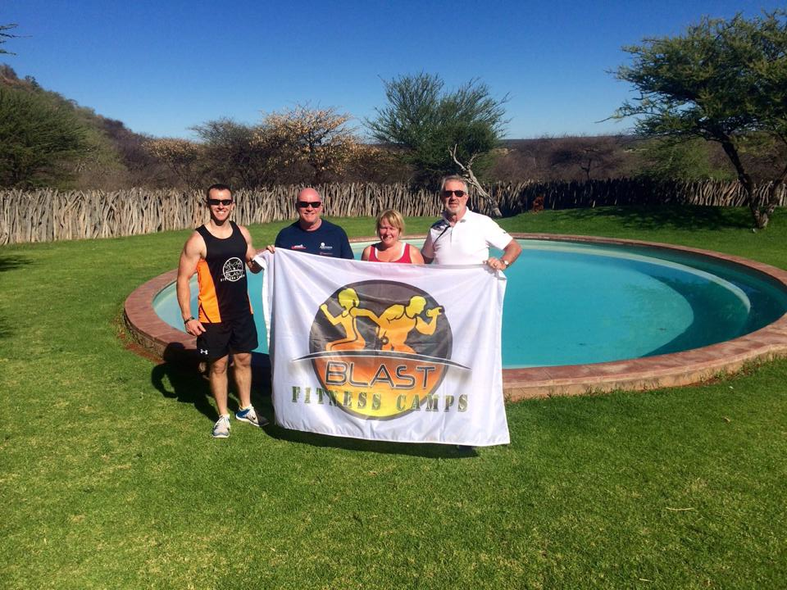

Slide 21
First Ironman- 53 and 65 Years of Age

Slide 22
Selection For GB Dragon Boat Team

Slide 23
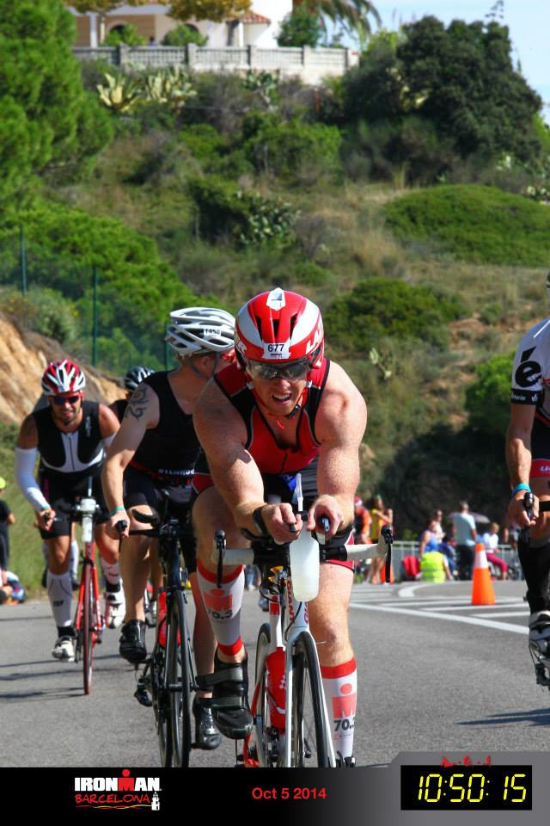
Rugby →To Top 5% in the world in age group Ironman in 2 years

Slide 24
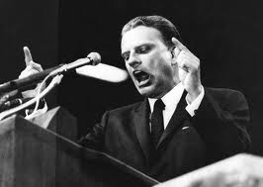
My Philosophy

Slide 25
Putting It In Perspective
Post
Training
Pre Training Meal
Regular Protein Intake Feeds
Overall Energy Intake & Breakfast
Recovery & Rest
Hydration
Friendships & Emotional Wellbeing- Smiles
SLEEP

Slide 26
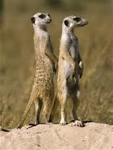
How To Improve Your Fitness/Performance
A Progressive Programme
Proper recovery
Supportive Nutrition
Excellent (not necessarily perfect)
lifestyle
BUT FIRST YOU MUST ADDRESS →→→→→→

Slide 27
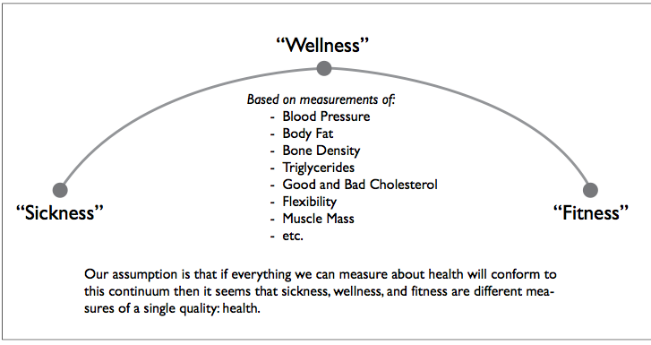
Health
Its NOT merely the absence of illness
Without Health you will never have optimal performance.
CrossFit Training Manual 2011

Slide 28
Fat Loss/ Body Composition
Reduction of toxins (ribenna)
Alkalising of blood
Reduction of sugar levels (sugar detox)
Reduction of total stress on the body
THE STRESS BUCKET- HOW FULL IS YOURS--------→

Slide 29
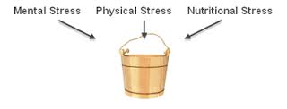
The Stress Bucket

Slide 30
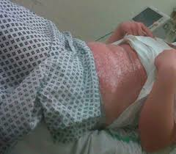
Minimum Effective Dosage
ASPARINS & SUNBEDS

Slide 31
3 Simple Steps To Reducing Nutritional Stress
1 . Keep It Simple without losing important principles
2. Clean , whole , naturally sourced (aim for excellence not perfection)
3. If it didn’t swim ,grow, run or fly or you cant pronounce it , don’t put it in your mouth.
WHEN ITS ALL SAID AND DONE THIS IS THE MOST IMPORTANT THING YOU WILL LEARN TONIGHT

Slide 32
4 Main Reasons We Get Sick
Toxicity
Acidity
Deficiency
Inflammation

Slide 33
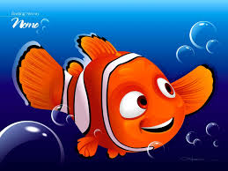
How To Get Sick & Die
Illness is inevitable throughout your life
Those who are healthy tend to recover quicker or suffer less severe symptoms
Fish are only as healthy as the environment they swim in ☺

Slide 34
Anti Oxidants: VERY Important When Training HARD
How:
By product of training are free radicals that cause damage at a cellular level.
Natural Sources:
berries, cherries, citrus, prunes, and olives. Green and white tea

Slide 35
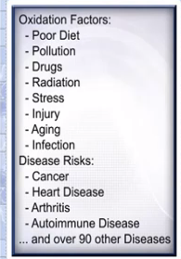
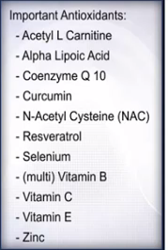
Anti Oxidants

Slide 36
Blood Stress: Reduce Acidity
Sugar- Cortisol – Insulin link
Avoid-
Artificial sweeteners
Antibiotics (and most drugs)
White flour products (including pasta)
Most boxed cereals Cheese
Shoot For-
Alkaline Foods
Green veggies
Drinks (lean greens)
Water

Slide 37
5 of The Roles The Liver Plays
Cleans the blood of toxins
Stores Glucose
Synthesises the non complete/non essential amino acids
Aids Digestion of fats
Production of SHBG
Milk Thistle (liquid) and My Grandma

Slide 38

Our Toxic Diet
E numbers
Additives
Preservatives
Emulsifiers
Colourings
Flavourings
MSG’s
Alcohol
Certain Sugars – (HFCS)
Anti Nutrients- crop sprays
Atmospheric pollutants- emissions

Slide 39
3 Phases To Reducing Toxicity
1.
Reduce Exposure- eliminate toxic products
2.
Actively seek to remove the chemicals that have accumulated in our bodies. Easily done through water and clean whole natural foods
3.
Support the detoxification pathways and organs that are involved in elimination. Eg Kidneys, lungs , liver , lymphatic system and the skin

Slide 40
What Happens When We Get Toxic?
Liver can’t filter all the toxins
It leaks the toxins back
These are then dumped in the fat stores with more fat and water laid down with them to protect the rest of the tissues/organs

Slide 41
There’s More Too...
The liver stops producing SHBG, which mops up excess Estrogen
Estrogen sensitive tissues now receive an overload of Estrogen hormones this encourages fat storage around these areas
Specific sites on for men and women

Slide 42
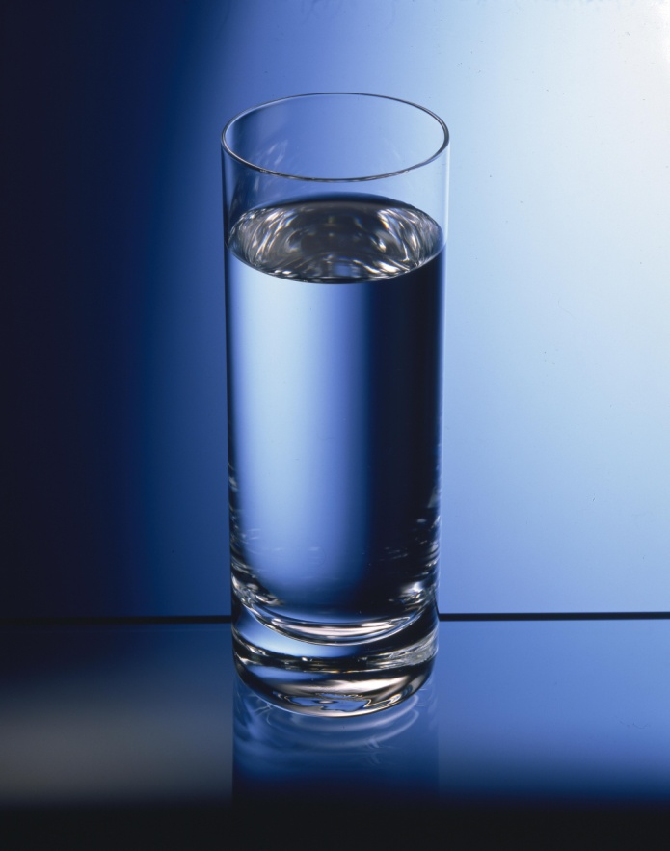
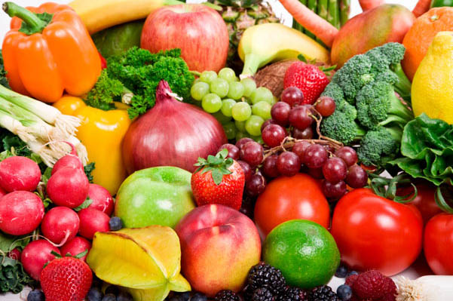
Where you can start?
My research shows 19-28 days of clean food and water is enough

Slide 43
Where We Like To Start Clients
When working with someone and their diet we always take the first steps towards health through addition and correction of their diet, before we begin to take things away, i.e. calories.
Weight Loss Considerations
Where the deficit or stimulus for weight loss comes from
  A deficit can be created by increased activity levels
  Reduction in overall food intake or periods of not eating (fasting)

Slide 44
NOT Calorie Counting…..
How we encourage the body to hold onto lean tissue, whilst using stored fat
  Protein intake optimised and more frequent
  Focus on quality of protein
  Exercise selection
The foods we eat (Carbohydrate and fat)
  Manipulate carbohydrates for sustained energy and satiety
  Reductions of energy dense, or conditionally non-essential nutrients

Slide 45
What Can I Eat?
Unlimited amounts of
More Limited amounts of
Vegetables
Meats
Fish
Eggs
Nuts and Seeds
Fruits
Fibrous foods bind to toxins In gastrointestinal tract.
Rice
Quinoa
Potatoes
Gluten free oats
Beans
lentils
No Limitations Just Keep It Clean!

Slide 46
How To Reduce Chances Of Getting Sick

Slide 47
Reduce Deficiency: Vitamins & Minerals
ADD SUPPORTIVE NUTRITION
Vitamin C (antioxidant)
Magnesium (repair/relaxation)
Zinc (repair)
+ FISH OILS (Omega 3’s)
Greens Drinks (alkalising)
WATER

Slide 48
Hydration
Water is essential for life, and maintaining hydration is important for physical and mental performance. The human body is largely made of water.
Body water content declines with age, from about 75% in babies to 60% in adults. Although we can live for up to 50 days without food, without water we will survive only a few days, even in a cool climate.
People generally drink enough water, but for specific population groups, like the elderly, or while exercising, fluid intake might become critical.

Slide 49
As A Detoxification Fluid
Toxins enter the body in food, water, through the skin and by inhalation. Our liver filters the blood to remove them or to deal with them through packaging for a later date.
Toxins are also created by biochemical reactions in the body such as when we break down fatty acids for energy during weight-loss programs
The liver transforms fat-soluble toxins into a water-soluble form. This enables them to be released through the kidneys for elimination in urine, or into bile for elimination through the colon.
We lose about 700ml of water just breathing…..so the one litre of water in a day is no where near enough.

Slide 50
Where To Start
Start the day with a drink
» Consider celtic sea salts – especially on an active morning or those in hot environments
– Salts promote the body to hold onto water, only a small pinch 0.1-0.2gram in 500ml of water is required
» Consume citrus
– A squeeze of lemon into water can not only flavour it nicely, but provides us with potassium, a crucial salt that we lose through perspiration and the bodies chemical reactions
Aim for approximately 1 litre per 50lbs of bodyweight or for those of you who work in metric Kg x 0.024 .

Slide 51
Zinc
Dietary zinc is also important for the skeleton, under-nourishment can lead to osteoporosis, Also, zinc is mostly a cofactor for over 100 proteins and enzymes, zinc is also vital for many enzymes that are involved in the synthesis of RNA and DNA, meaning it’s vital in gene transcription and recovery as-well as being vital in hormone receptors for vitamin D, oestrogen and testosterone.
Zinc is also a vital component in superoxide dismutase, a key antioxidant enzyme and regulation of other antioxidants what could cause damage if allowed to build. Zinc also effects carbohydrate metabolism,

Slide 52
Magnesium
Magnesium is used all around the body in hundreds of biological processes, however, sometimes the things we do place an extra demand on the body – and magnesium can really take a hit!
We lose more of this in our urine when we train
Involved in neuromuscular, cardiovascular, immune, and hormonal function!
Temporary conditions such as hypomagnesaemia occur after strenuous exercise, suggests that we can induce magnesium deficiency doing what we “love”, training.
Magnesium levels have also been positively related to maximal muscle contraction ability.
Natural muscle relaxant

Slide 53
Vitamin C
important in glucose metabolism and injury recovery, and acts as an antioxidant, enhances iron uptake, frequently prescribed with iron supplements, 25mg of vit c with meals can increase iron availability by 65%
Vitamin C is necessary for collagen synthesis and production, so it can be very important in recovery and injury cases.
Extreme deficiency is well known as causing scurvy and bone disease, children can be especially susceptible to this issue.
Symptoms can be bone pain, bleeding and fractures around the bones growth plates, although scurvy is rare, it still occurs with some crazy fad diets that parents force their kids into, so still be aware of it.
Smokers are also at risk of a C deficiency, although all round vitamin C deficiency is rare.
One of the major causal factors in heart attacks

Slide 54
Non Citrus - Natural Sources Of Vit C
Red and Green Chilli Pepper
Sweet potato
Thyme/ parsley
Bell peppers
Kale
Watercress
Broccoli
Strawberries
Kiwi’s

Slide 55
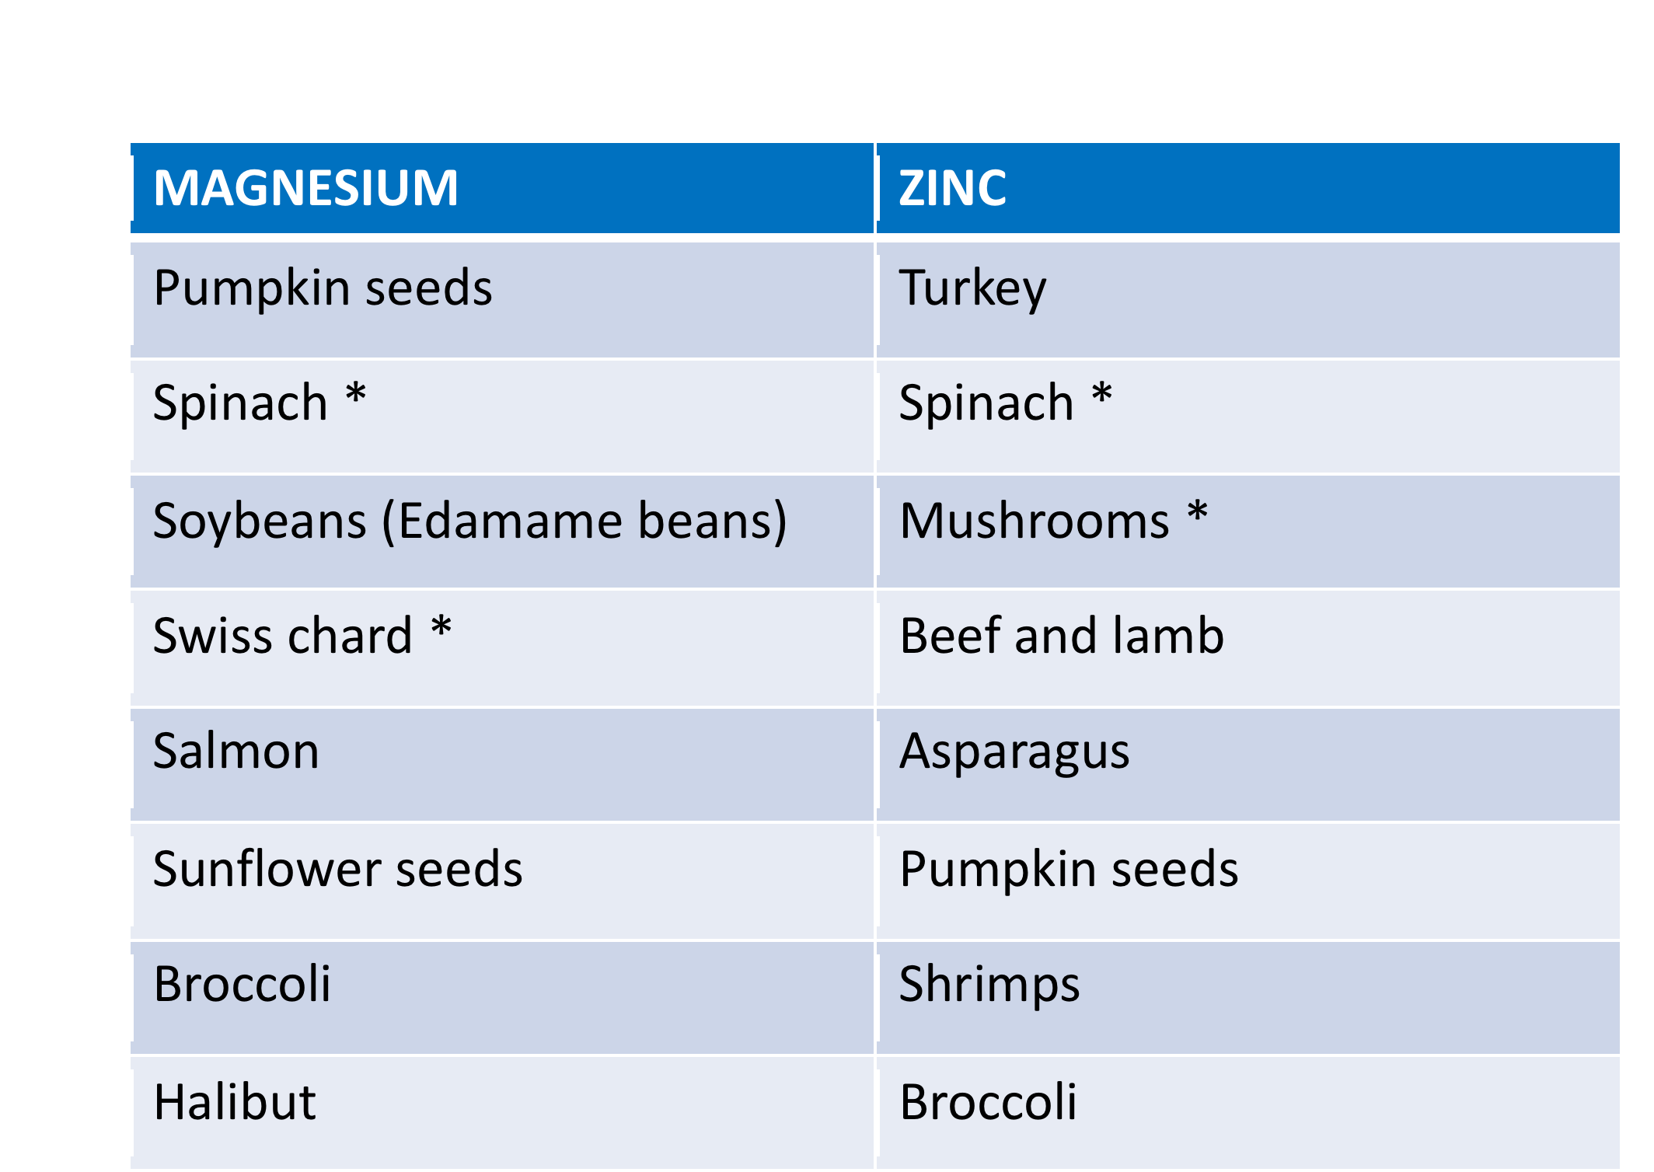
Natural Sources Of Magnesium/Zinc

Slide 56
Non Fish Sources of Omega 3’s
Flaxseeds / oil
Eggs
Chia seeds
Hemp seeds
Cauliflower
Hummus
Brussel sprouts

Slide 57

The Most Under Rated Aspect of Health

Slide 58
Sleep
Tends to be directly related to energy levels
Recovery and learning are affected by this.
Circadian rhythm (24 hour period)
We like patterns (in built clock)
Blue/ red light
Influenced by temps, eating habits and light
Tissue and nervous system repair inhibited by lack of sleep
25-30% of our lives sleeping, so that’s pretty important part.

Slide 59
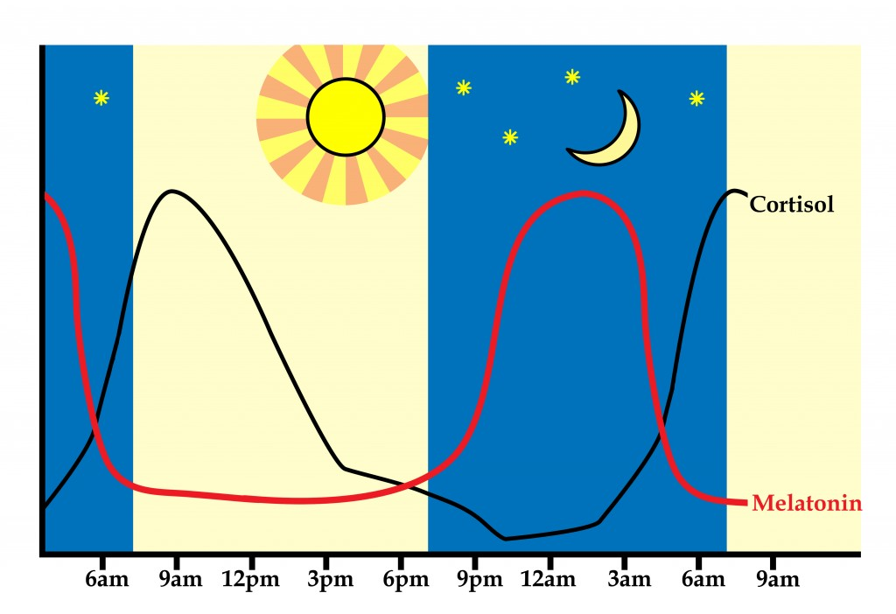
Hormones and Your Sleep

Slide 60
Daylight
Eyes are responsible for this
White and blue light – SAD Treatment uses
Red Lights – candles etc
Sleep helps the nervous system repair due to a temporary state of paralysis.
Blue light hitting the eye suppresses melatonin
Proper rest increases melatonin and Hgh

Slide 61
Types of sleep
REM- rapid eye movement (40-60 mins after going to bed)
Environmental distractions, lifestyle issues and nutritional interactions can make it difficult for people to transition to this part of the sleep cycle.
Light Non- REM sleep- semi awake semi asleep, easily disturbed. You go from deep to light , deep to light

Slide 62
Gut Health and Pills n Powder based diets
Lack of fibre will cause a problem with digestion but also with vitamin uptake.
Ideal “shake” from natural sources come in the form of greens drinks:
Hydrate/salts/ insoluble fibre/soluble fibre
Add ginger/carrots/cucumber/berries etc
There is a HUGE difference between a “supplement” and a “meal replacement”.

Slide 63
Basic Supplementation
Supplement – ‘A thing added to something else in order to complete or enhance it’
We use supplements with clients to enhance their diet, or to improve their performance and also to fill in gaps in their diet that may be caused by illness or lifestyle choices.

Slide 64
3 Types Of Supplements
We can group supplements into various categories, broadly speaking there can be three of these.
Ergogenic aids
Recovery aids
Healthful supplement
Supplements that help us perform better, improve our recovery or ability to handle the strains of training and lifestyle and supplements that support the everyday working of our body.

Slide 65
Supportive Nutrition
Once we have done the best we can with our client’s physical diet we can look to using food supplements to further improve it, we can look at using performance enhancing supplements to improve their results from training

Slide 66
Specific Needs
And we can also start to take a look at specific health related supplements, by taking into account their lifestyle or work/like situation which may make obtaining certain nutrients difficult, such as
Lack of sunlight exposure leading to vitamin D issues
Tulsi Tea and Rhadiola, vitamin C for excessive stress.
Following a vegetarian diet and the nutrient difficulties associated with excluding certain food groups
or their choice of performing frequent long duration training and the impact it will have on salt/mineral levels (such as magnesium and electrolytes), glutamine and Vitamin E.

Slide 67
Where To Start
We can list all these factors in order of importance and ease of addressing and come up with a sensible, applicable and affordable supplement approach with our clients
BCAA’s
Fish Oils
Zinc and Magnesium

Slide 68
Supplementation Considerations – Do We Actually Need To Supplement?
Activity levels
  An active client will use more minerals/salts and put more stress on their system
  Lower activity levels do not normally warrant supplementation (rarely recommended)
Food intake
  When maintaining a deficit, we put ourselves in a state of reduced intake and potentially lower essential nutrients
  Someone eating a wide variety of foods may only require the bare minimum of supplementation based on their activity choices

Slide 69
Supplement Needs
Appetite related
  Increased protein and carbohydrate intakes can be difficult for some
Lifestyle
  Supplementation can help manage stresses (adaptogens)
  Combat habits such as being indoors all the time
  Smoking can increase needs for iron in the diet (we don’t take on smokers unless they are giving up at the same time)
Allergy/Intolerance
  Certain pathologies effect nutrient uptake (coeliac)
  Vegetarianism might make B-Vitamins a concern

Slide 70
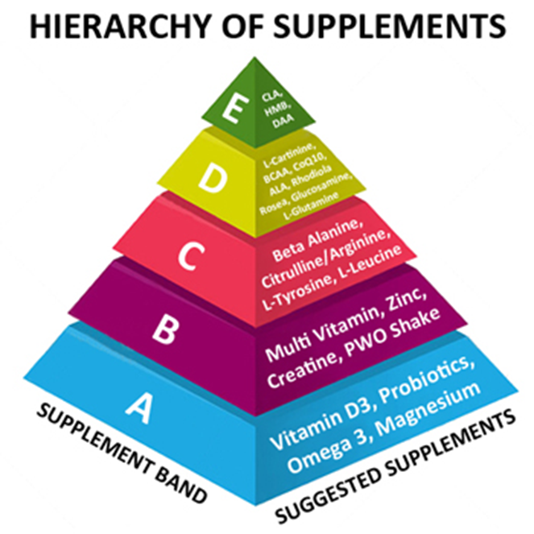
Supplements

Slide 71
Setting Up Your Kitchen
Tuperware boxes for nuts and seeds
Water bottles (600ml minimum)
Get coconut or macadamia nut oil for cooking
Olive oil for dressings
Nutribullet/blender

Slide 72
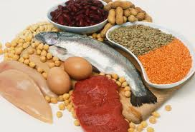
Good Sources of Protein
Chicken
Turkey
Fish- salmon, makerel, oily fish
Beef
Beans- chickpeas,
Quinoa
Eggs

Slide 73
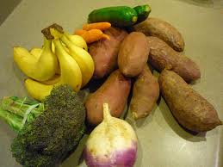
Good Sources Of Carbohydrates
Brown rice
Sweet potato
Basmati rice
Quinoa
Oats
Lentils
Fruit and veggies

Slide 74
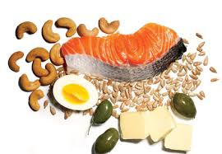
Good Sources Of Fats
Avocado
Almonds
Brazil nuts
Pine nuts
Pumpkin seeds
Sunflower seeds
Cashew nuts

Slide 75
Foods That Should Always Be In Stock
1 dozen eggs
1 red pepper
1 small red onion
1 bag baby spinach
1 avocado
1 jar coconut oil
1 pack fresh raspberries
1 pack fresh blueberries
2 pounds lean ground beef /turkey mince or turkey steaks
1 broccoli
1 carton unsweetened almond or oat milk
curry powder or garam masala
paprika
garlic
red chilli flakes
sea salt
Pepper
2 medium-sized sweet potatoes
1 bottle olive oil
raw mixed nut mixture (pecans, cashews, macadamia, almonds)
1 jar almond butter
1 container vanilla protein powder (sunwarrior)
1 carton of coconut milk
1 bag frozen (not always) mixed berries

Slide 76

Nutrition Is King

Slide 77
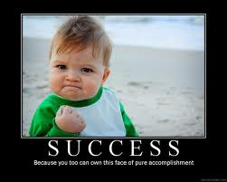
People Who Are Most Successful
Never skip “breakfast” (whether its before or after training)--- **fasting **
They vary the sources of protein
Always consume carbohydrates (fibrous or non fibrous) at breakfast and after training (lower fibre).
Look at the nutrient
value of foods BEFORE
the calories

Slide 78
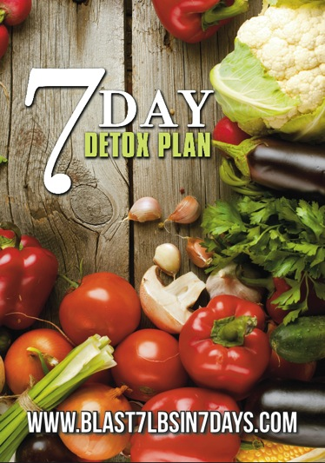
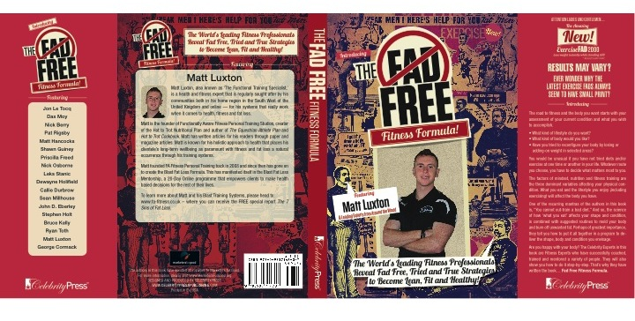




Slide 79

QUESTIONS

